Slide 1
Strengthening municipal grievance redressal
Nisheeth
IIT Kanpur

Slide 2
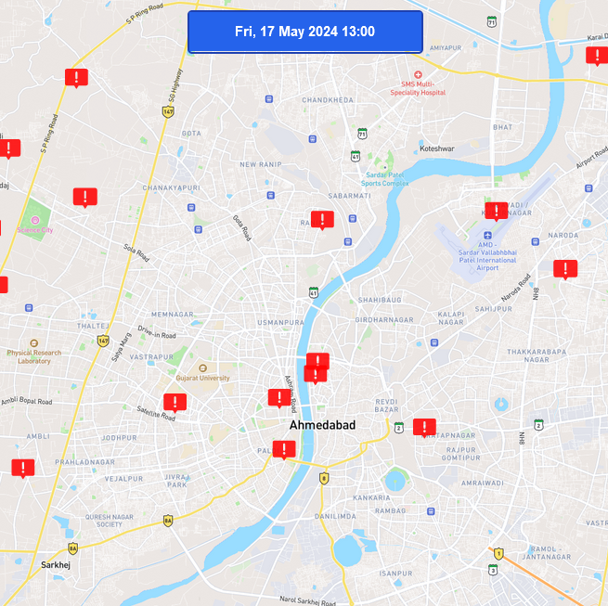
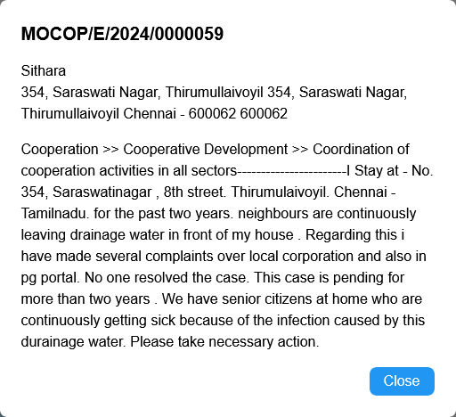
Grievance Redressal at the Municipal Level
ULBs have local grievance redressal portals
Low visibility and awareness
Citizens flood CPGRAMS with grievances related to municipal functions
There remain unaddressed
How do we connect CPGRAMS with ULBs?
No clear administrative mapping

Slide 3
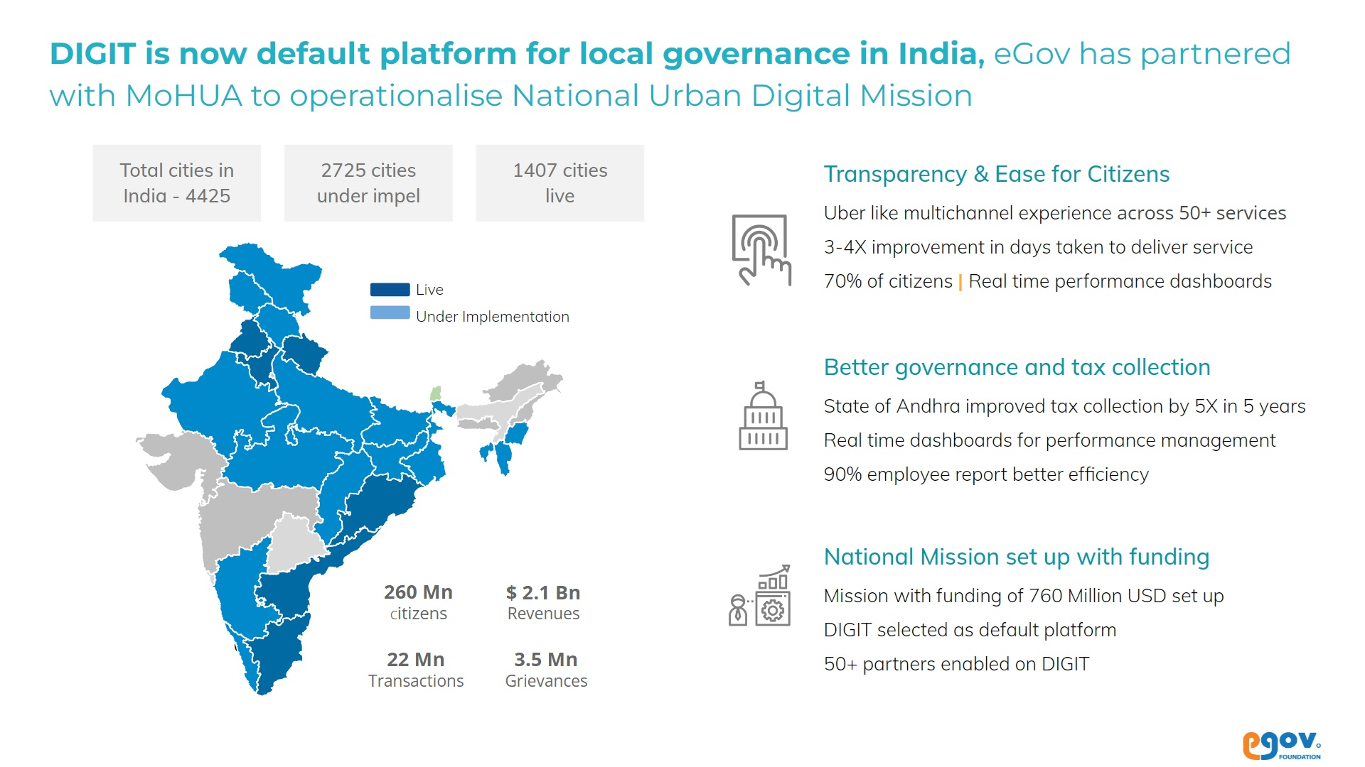

Slide 4
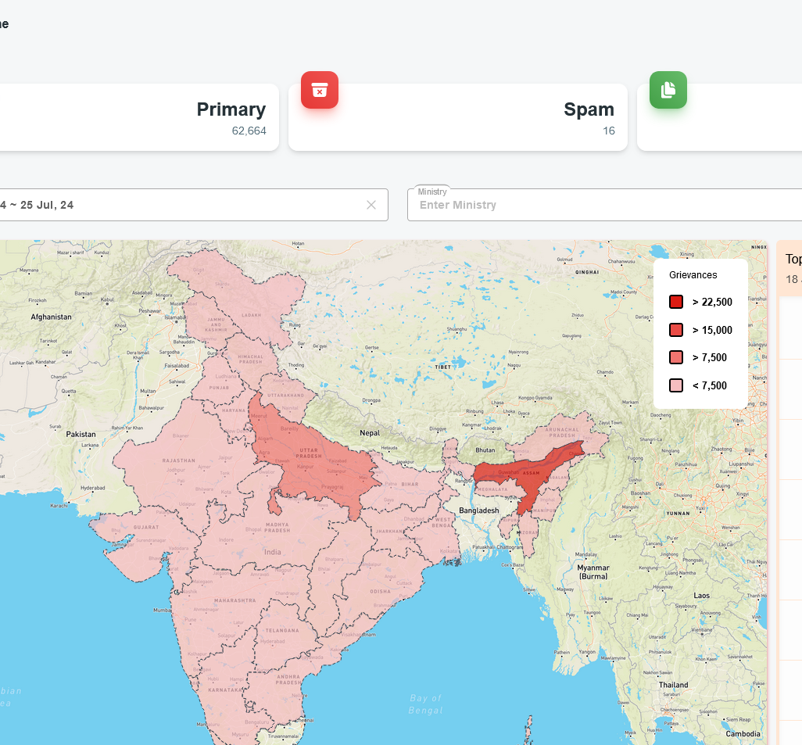
AI for e-governance: an IITK success story
Intelligent Grievance Management System (2022)
Deployed across all central government departments
National award for e-governance (2022)
Semantic indexing of grievances based on grievance text, metadata and attachments
Multilingual semantic search across categories
Dynamic root cause analysis
Several other AI capabilities

Slide 5
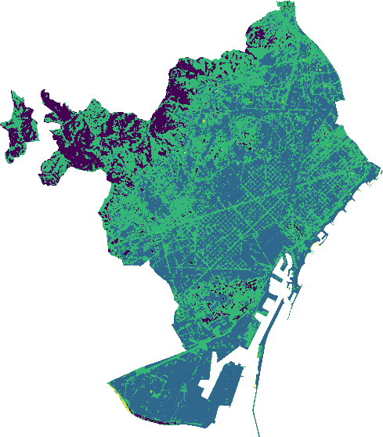
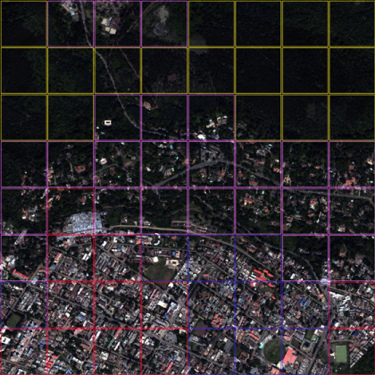
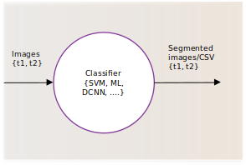
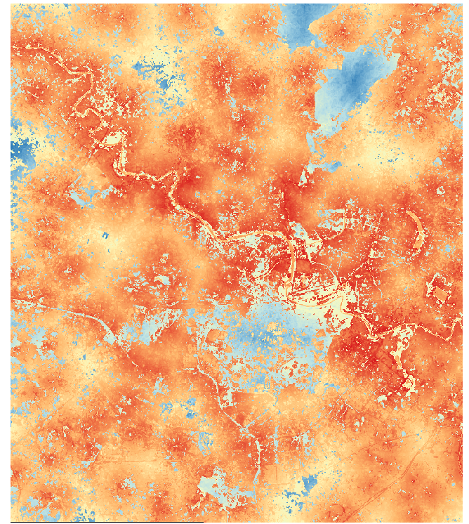
Urban Metabolism Modeling
Flood susceptibility models use:
LULC estimates
Water body proximity
DEM
Slope
This is just one example. IITK and TCS are working on many related models to produce an overarching urban metabolism modeling framework.

Slide 6
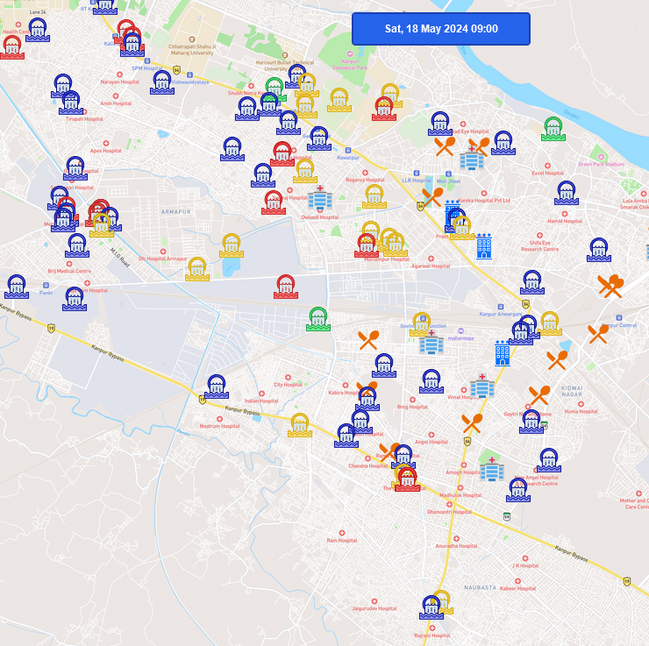
Omni-channel problem discovery
Omni-channel problem discovery using semantic search
Garbage disposal
Urban flooding
Health and sanitation
Augments public grievances filed on CPGRAMS
Data: Live data from CPGRAMS and Chennai Smart City
Models: kNN classifiers trained on BERT embeddings of CPGRAMS data

